Slide 1
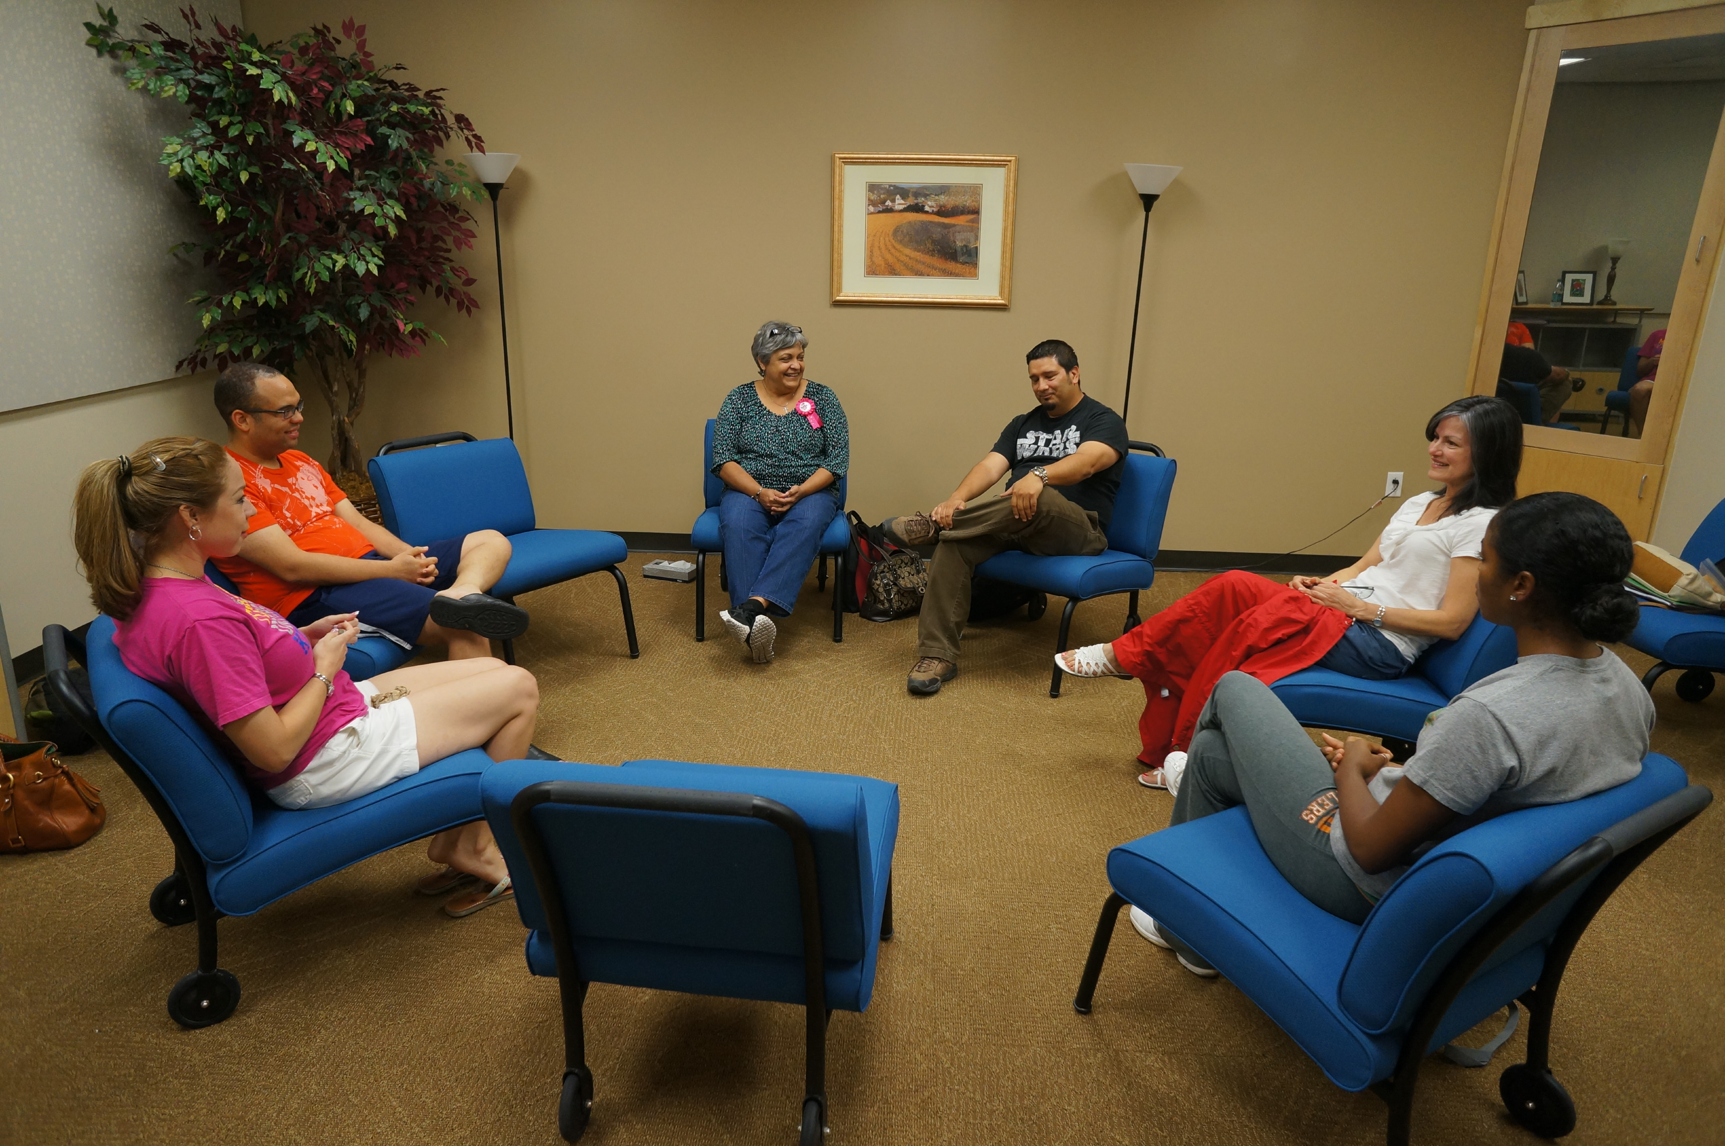
Gregory Scott Sparrow, EdD, LPC-S, LMFT (Va)
Professor, University of Texas Rio Grande Valley
Founder, DreamStar Institute
www.dreamanalysistraining.com
Co-Creative Dream Analysis
and the FiveStar Method

Slide 2
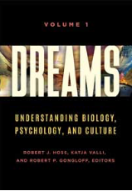
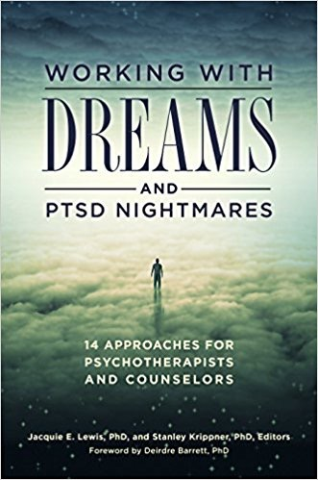
This presentation is based on recently published chapters

Slide 3
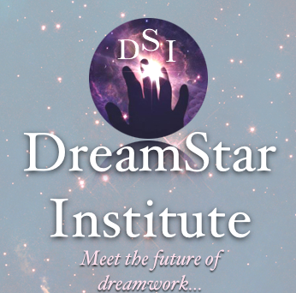
And other papers, journal articles, and interviews that can be found at www.dreamanalysistraining.com

Slide 4
Three things I want to cover…
A new approach to dreams called the Co-Creative Paradigm (CCP)
A five-step method based on this approach, called the FiveStar Method
An example that we’ll work with together

Slide 5
A few months after I had become licensed as an LPC in 1982, I accepted a referral…
Gwen’s dream:
I have returned home after being away, and arrive late for a family picnic beside a lake. When I go to get something to eat, I discover that all the food has been eaten. Only the bones of a large fish remain on a platter. I take the platter down to the edge of the lake to wash it off. As I lower it into the water, the bones come to life again. The fish shimmers with color and swims away.

Slide 6
In the dream work with Gwen…
The situation and imagery depicted her alienated and impoverished emotional state.
But an exclusive focus on the imagery would have overlooked the most significant aspect of the dream ‒ Gwen’s remarkable response.
Her response clearly facilitated the transformation of the fish!
Thereafter, it was the “exceptional moment” that offset her view of herself as hopeless and broken.

Slide 7
We know that…
Dream sharing accelerates and deepens the therapeutic process.
Dream sharing achieves better outcomes than insight therapy alone.
Not many counselors initiate dream sharing. Why?

Slide 8
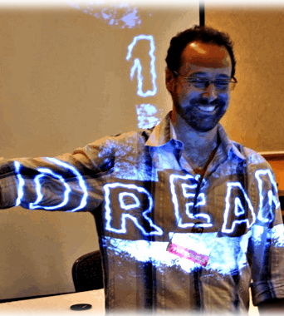
The Problem…
Therapists don’t receive university training in dream analysis.
Therapists view dream analysis as interpreting the dream content.
This seems to take the focus off our clients’ here-and-now concerns and resources—their choices, responses to life, relationships and goals.

Slide 9
Freud gave us Two Unfortunate and untrue Assumptions…
the discontinuity HYPOTHESis
The Deficiency HYPOTHESis

Slide 10
Freud gave us…the discontinuity HYPOTHESIS
Freud believed that dreams…
express unacceptable, unresolved impulses of a sexual and aggressive nature pertaining to one’s past.
are formed outside of the ego’s awareness.
are disguised to circumvent the ego’s resistances.
are “strictly determined” before we experience them.
are presumably bizarre and unlike waking life, thus DISCONTINUOUS.

Slide 11
The Discontinuity HYPOTHESiS Have been CHALLENGED by Studies that show….
The characters and scenarios in dreams are less bizarre that once thought.
Dream imagery and scenarios generally parallel waking life.
…thus overturning the DISCONTINUITY HYPOTHESIS.

Slide 12
the Deficiency HYPOTHESIS
Freud believed the dream ego was…
uninvolved in the dream’s formation
resistant to perceiving the dream’s true thrust during the dream and upon awakening.
incapable of influencing the dream’s development and outcome, thus DEFICIENT in reflectiveness and agency.
Gwen’s remarkable response would have been regarded as scripted—not a remarkable choice—within Freud’s view of the dreamer.

Slide 13
The Deficiency HYPOTHESiS Has been CHALLENGED by….
Lucid dreaming
Recent studies that indicate that dreamers are more aware and responsive in non-lucid dreams than previously thought
Rossi, Purcell, Sparrow (1970s-1980s)
Kahan, Kosmova (1990s-present)

Slide 14
The Deficiency HYPOTHESiS Has been CHALLENGED by….
Rossi’s game-changing hypothesis, from Dreams and the Growth of Personality:
There is "a continuum of all possible balances of control between the autonomous process and the dreamer’s self-awareness and consciously directed effort" (1972, p.163)
…thus challenging the DREAMER DEFICIENCY HYPOTHESIS.

Slide 15
This combined CHALLENGE gives rise to…
The Co-Creative Dream Paradigm
My discovery of the co-creative dream paradigm began in the 70s when I started having “lucid dreams, and discovered Rossi’s work.
I did my masters thesis and doctoral dissertation on lucid dreaming, and wrote the first book on lucid dreaming published in North America.
As a psychotherapist, I foresaw how lucidity could conceivably help resolve longstanding conflict and trauma.

Slide 16
dreamers exhibit reflective awareness in ordinary dreams…
Lucid dreaming is difficult to induce for the average person.
As early as 1982, I shifted my attention to “ordinary dreams,” discovering that dreamers exhibit significant reflectiveness and responsiveness without acknowledging it.
More recently, several researchers, many of whom are IASD members, have confirmed that dreamers possess significant reflective awareness, or “metacognition” in dreams.

Slide 17
The Co-Creative Dream Paradigm is based ON…
Dreamers not only reflect within dreams, but…
make choices and respond freely to the dream content.
exercise this capacity in virtually every dream.
Dream content shifts and adapts to the dreamer’s responses.
Dreams are co-created through the interaction between the dream ego and the dream content — similar to Quantum theory
The interactive process gives rise to one of many possible outcomes, just like real life!

Slide 18
If we treat the dream as a “Strictly determined,” Then…
The dream is predetermined, and complete without dream ego input!
The dreamer’s actions and thoughts have no bearing on the dream outcome.
Fritz Perls: "You prevent yourself from achieving what you want to achieve…You experience this as some other power that is preventing you.”
Fixed narrative
Dream Ego

Slide 19
The Cocreative paradigm
There are two separate structures:
the emergent generic content
the witnessing dream self, who is free to feel, to reflect, and to act.
Dream Ego
Emergent Generic Content

Slide 20
As the dream ego encounters the content, there may be dissonance. (Ullman and Cayce).
A felt dissonance is the “first cause” of the dream emergence.
The dream imagery arises as an expression of the moment-to-moment dissonance on the mutable dream interface.
Dreams are “Metaphors in Motion” (Ullman), mapping the encounter.
Mutable Interface
Dream Ego
Emergent Generic Content

Slide 21
The dream imagery is not the content!
The content is generic and pertains to a broad domain, like a manakin! The archetype is pattern, not image (Jung)
The encounter co-creates a specific image, related to personal experience, hence metaphoric.
“Manakin”
“Co-created image”
Dream Ego
Emergent Generic Content
Mutable Interface

Slide 22
The Co-Creative Dream Paradigm…
Dreams can be analyzed just as any relationship can be analyzed—that is, as an interactive exchange between dreamer and dream content.
The dream’s purpose is to facilitate the encounter, provoking the dream ego into resolving the dissonance, and achieving integration.
Integration depends on how the dreamer responds to the content.
The dreamer’s responses mirror waking attitudes and actions toward similar issues—parallel process

Slide 23
The Co-Creative Dream Paradigm supports new questions…
The traditional approach asks, “What does this image mean or refer to?”
CCD asks,
How did the dreamer respond to the dream imagery and what does this say about his/her relationship to the (domain level) issue presented?”
Other questions naturally follow: “How did the dreamer’s responses impact and alter the dream imagery, and vice versa?”
Family therapists will recognize such questions as process questions, which underscore the reciprocal dynamics between family members.

Slide 24
The Co-Creative Dream Paradigm supports new questions…
CCP shifts the emphasis onto the relationship between dreamer and dream.
The emphasis on relational process reveals one’s relational style, thus making the dream imagery more easily and naturally understandable within the relationship context, rather than as set-apart objects within the dream.

Slide 25
The Co-Creative Dream Paradigm Reduces hazards…
Dreamwork focuses on demonstrable responses and relational dynamics
It empowers the dreamer to recognizes competencies, and revise habitual reactive patterns.
Dreamwork deemphasizes “interpretation” or statements drawing an equivalency between the image and what is already known.
It works with the image, never reducing it to a simple a=b.
The image never loses its power to inform and transform us.

Slide 26
Let’s look at another client dream
A 45 year-old woman shared the following dream toward the end of her treatment.
I awake to find myself on a bed. I look up and see holes in the ceiling, and rats dropping down through the holes. Horrified, I jump and run out of the room. The rats seem to chase me, so I fearfully run up a stairway to get away from them. When I reach the top, I turn around to see if the rats are still following me. A huge rat is climbing the stairs and is within a few steps of where I stand. I look at it closely, and I’m surprised to see that its fur looks soft and lustrous. Intrigued by its beauty, I reach down as it comes closer and touch its fur. As soon as I do, the rat changes into a snow leopard. I am spellbound by its beauty, and awaken.

Slide 27
Let’s look at another client dream from
the co-creative paradigm…
The most important aspect of this dream is…?
Upon reflection, the dream exposed the dreamer to the fear and aversion connected to unresolved emotional threat.
She concluded that the rats captured the feeling of the abhorrent, invasive experiences of her childhood.

Slide 28
Let’s look at another client dream from
the co-creative paradigm…
But she also realized later that the rats represented her view of her own body and instincts.
While these insights are valuable, the more significant aspect of this dream is her willingness to turn around see beauty in the rat.

Slide 29
This act became the pivotal moment in the dream, transforming the dream.
The dream ego’s response and the potentials inherent in the domain-level issue coalesced a new metaphor on the dream interface!
The snow leopard thereafter served as a powerful metaphor, uniting spirituality with instinct.
The dreamer’s courage in the face of the disgusting threat was the most important thing to focus on from the standpoint of therapy.

Slide 30
The client shared a final dream before leaving therapy:
I am in my kitchen alone at night, and I hear something outside the screen door. I peer through the screen and see that it is a hyena. I believe it is hungry, so I put some food in a bowl, open the door and put it in front of the animal. It begins to eat.

Slide 31
The FiveStar Method—40 years in the making
The FSM is my own approach to co-creative dreamwork.
Co-creative dreamwork can be practiced according to your own style, as long as you focus on…
The dreamer’s responses—emotionally, cognitive, behaviorally––which are the most important determining aspects of the dream experience, and that the dream is not fixed from the outset, but co-created, or co-determined by the reciprocal interplay.

Slide 32
The FiveStar Method
Step One: Sharing the Dream and Feelings
Ask the dreamer to tell the dream in the first-person, present tense (Perls started this.)
Listen to the dream as if it were your own dream (vicarious appropriation).
Identify with the dreamer, notice the feelings that you have. and ask the dreamer to share his or her feelings that are aroused by the dream, and then share your own, as well.
Have the dreamer repeat the dream unless a copy is viewable, so that the imagined dream is based on the actual report.

Slide 33
The FiveStar Method
Step One…
Establishes rapport
Guards against jarring exchanges.
Conveys the idea that the dream is still alive, not over
Conveys the idea that the dreamwork advances the dream experience forward toward integration and meaning.
Vicarious appropriation converts the dream from a “there-and-then” individual experience into a “here-and-now, living, shared experience.

Slide 34
The FiveStar MethoD
Step Two: Formulating the Theme
Reduce the dream to a brief content-free summary that uses pronouns like “someone,” “something,” or “somewhere” to replace people, objects, and places. Examples:
Dream of the fish bones: Someone faces a situation in which there is nothing available, but takes action facilitates an unexpected renewal.
Dream of the rats—“Someone tries to get away from something she perceives to be threatening, but by confronting the situation, she is able to view the situation differently.”

Slide 35
The FiveStar Method
Step Three: Dreamer Response and Imagery Change Analysis
Highlight the places where the dreamer responded emotionally or behaviorally, and
Highlight the reciprocal changes in the imagery:
Dream of fish—“When you took the remains down to the water, and the fish came back to life.
Dream of rats—“You ran from the rats. You reconsidered and turned around, and the rats transformed into a snow leopard.”

Slide 36
The FiveStar Method
Follow up with questions such as:
“Is this a new response, or is it familiar?”
“What was constructive about your response?”
“What was unfortunate about your response?”
Get the dream group to comment on the dreamers’ responses, and to imagine their own.
Then the dream worker asks :
“What do you wish you had done differently?”
“How do you think the dream character/situation would have responded to that?”

Slide 37
The FiveStar Method
Step Four: Imagery Analysis with non-interpretive methods
1) Amplification: (Easy and sufficient) The dreamer shares his or her associations with the images. The dream worker/dream group can also provide associations and qualified (If this were my dream…) suggestions as well, but the dreamer is the final authority.
2) Gestalt/Parts of Self Analysis: (More advanced) Ask the dreamer to describe himself as the image. Facilitate dialoguing between the image and dreamer without regard to a “conclusion.”

Slide 38
The FiveStar Method
Step Five: Homework
Ask “Where is this relational pattern occurring in your life?”
Ask “What would you like to do differently in the waking state context, or in the dream, if this type of encounter should arise again?”
Use “Dream Reliving” to imagine the new responses and the new dream outcome.
Support the enactment of new responses in the waking state or in the dream state, or both.
If possible, review in subsequent sessions the efforts made and results achieved.

Slide 39
Let’s Do it!
Step 1 - Dreamer tells dream in first person, present tense.
I am on a trip with my two best friends. I feel that I need to get somewhere to meet a man, but the car starts to pull over in spite of my efforts to turn the steering wheel. It comes to a stop in a field where a carnival has set up. My friends want to spend some time at the carnival, but I am eager to keep going. I grow impatient with them, and I yell to them that if they don’t join me, I will leave alone. Then I am by myself on foot, preparing to cross a highway. A tractor trailer bears down on me, which scares me at first, but then I am able to step back to safety, and it shoots

Slide 40
Let’s Do it!
past. Then I continue on my journey. I stop at a house where several of my friends greet me, and hope that I will stay for a while. But I feel that I must be on my way, so I excuse myself, and continue. Finally I reach a harbor, where a man greets me next to a docked ocean liner. He and I go aboard the ship, and the captain, whom I do not know, prepares to embark.

Slide 41
Let’s Do it!
Step 2 - Summarize the basic theme or action of the dream.
Someone is…

Slide 42
Let’s Do it!
Step 2 - Summarize the basic theme or action of the dream.
Someone is…

Slide 43
Let’s Do it!
Step 3 - Analyze the dreamer's responses and their impact on the imagery.
1.
2.
3.
4.
5.
What was desirable, creative or bold about the dreamer’s responses? If you’d been the dreamer, is there any response you would change if you had this dream again?

Slide 44
Let’s Do it!
Step 3 - Analyze the dreamer's responses and their impact on the imagery.
1.
2.
3.
4.
5.
What was desirable, creative or bold about the dreamer’s responses? If you’d been the dreamer, is there any response you would change if you had this dream again?

Slide 45
Let’s Do it!
Step 4 - Analyze the imagery
Amplification—(Basic and sufficient) Ask the dreamer to provide associations

Slide 46
Let’s Do it!
Step 4 - Analyze the imagery
Amplification—(Basic and sufficient) Ask the dreamer to provide associations

Slide 47
Let’s Do it!
Step 4 - Analyze the imagery
Parts of Self Analysis (more advanced)
What do you think you would encourage the dreamer to identify with, and then dialogue with? Always use Gestalt questions, which are open-ended, awareness-enhancing, feeling based.
What do you want to say to…?
What do you want from…?
What do you feel?
What are you aware of?
What do you offer the dreamer (or dream image)”

Slide 48
Let’s Do it!
Step 5: Applying the dream and dream reliving (dreaming forward)—Parallel process is more important than parallel content
Is there any place in your life where this relational process is underway?
What responses did you you make, or could make, to your waking life experiences that would allow this encounter to unfold and move toward your deepest goals?
Close your eyes for a minute and relive the dream, implementing whatever new responses that you made, or would like to make in relation to this life issue?

Slide 49
Let’s Do it!
As I walk around this lower level I can see that the foundation room's walls are made of concrete and the concrete is still wet as if it had just been poured. I approach a closet with much interest and I open the closet door and see two antique sets of golf clubs. I notice that the golf clubs are, indeed, vintage and in my dream I perceive that they have value/worth. All of a sudden, I hear my father's voice say something to the effect of, "Wow, son, those are some nice clubs!" When I hear my father's voice say this I feel a sense of happiness. I examine the golf clubs a little more and my dream ends in that moment.

Slide 50
The FiveStar Method, in summary…
Highlight dreamer-dream relational dynamics
Supports client competencies, by highlighting problematic reactive patterns, increasing relational competency.
Imagery analysis becomes easier since the first three steps establish the context.
Is designed to foster greater awareness in future dreams and parallel waking experiences.
When these responses are rehearsed in one’s imagination through dream reliving, they tend to carry over into future dreams.

Slide 51
The FiveStar Method
Aligns with a variety of approaches to counseling.
Focuses on the dreamer as agent of change
Focuses on content within a changing relational framework, less invasive and final.
Applies new attitudes and and responses to relationships in dreams and in waking life, and thus accelerates the process toward wholeness and healing.
“You must be the change you wish to see in the world.” Ghandi
…and in your dreams!

Slide 52
Gregory Scott Sparrow, EdD, LPC-S, LMFT (Va)
Professor, University of Texas Rio Grande Valley
Founder, DreamStar Institute
www.dreamanalysistraining.com
Co-Creative Dream Analysis
and the FiveStar Method

